Slide 1
Searching Techniques
By
Anusha Bellala

Slide 2
Bubble Sort
Bubble sort is a sorting algorithm that compares two adjacent elements and swaps them until they are not in the intended order.
Working of Bubble Sort:
Suppose we are trying to sort the elements in ascending order.
Iteration (Compare and Swap):
Starting from the first index, compare the first and the second elements.
If the first element is greater than the second element, they are swapped.
Now, compare the second and the third elements. Swap them if they are not in order.
The above process goes on until the last element.

Slide 3
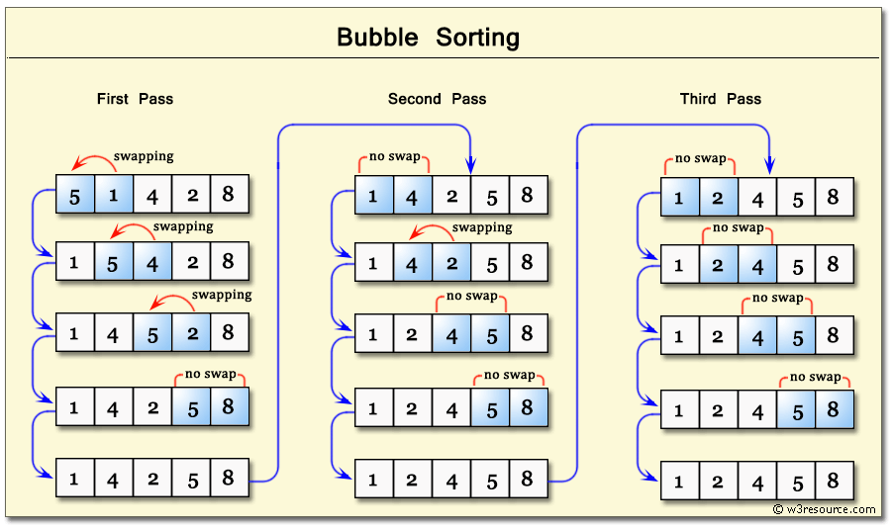

Slide 4

Bubble sort program
using System;
using System.Collections.Generic;
using System.Linq;
using System.Text;
using System.Threading.Tasks;
namespace Bubblesort
{
internal class Program
{
static void Main(string[] args)
{
int[] arr = { 5, 1, 4, 2, 8 };
int temp;
for (int j = 0; j <= arr.Length - 2; j++)
{
for (int i = 0; i <= arr.Length - 2; i++)
{
if (arr[i] > arr[i + 1])
{
temp = arr[i + 1];
arr[i + 1] = arr[i];
arr[i] = temp;
}
}
}
Console.WriteLine("Sorted:");
foreach (int p in arr)
Console.Write(p + " ");
Console.Read();
}
}
}

Slide 5
Linear Search
the Linear Search Algorithm. Searching is the process of finding some particular element in the list. If the element is present in the list, then the process is called successful, and the process returns the location of that element; otherwise, the search is called unsuccessful.
A simple approach is to do a linear search:
Start from the leftmost element of arr[] and one by one compare x with each element of arr[].
If x matches with an element, return the index.
If x doesn’t match with any of elements, return -1.

Slide 6
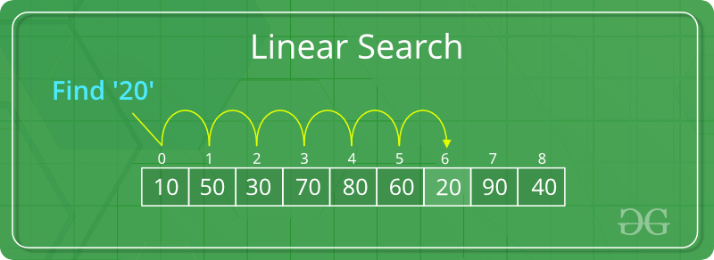

Slide 7
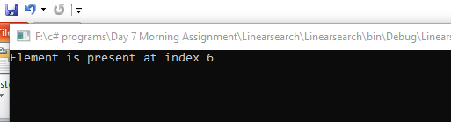
Linear search program
using System;
using System.Collections.Generic;
using System.Linq;
using System.Text;
using System.Threading.Tasks;
namespace Linearsearch
{
class Searching
{
public static int search(int[] arr, int x)
{
int n = arr.Length;
for (int i = 0; i < n; i++)
{
if (arr[i] == x)
return i;
}
return -1;
}
internal class Program
{
static void Main(string[] args)
{
int[] arr = { 10, 50, 30, 70, 80, 60, 20, 90, 40 };

Slide 8
int x = 20;
// Function call
int result = search(arr, x);
if (result == -1)
Console.WriteLine("Element is not present in array");
else
Console.WriteLine("Element is present at index " + result);
Console.ReadLine();
}
}
}
}

Slide 9
Binary search
Search a sorted array by repeatedly dividing the search interval in half. Begin with an interval covering the whole array. If the value of the search key is less than the item in the middle of the interval, narrow the interval to the lower half. Otherwise, narrow it to the upper half. Repeatedly check until the value is found or the interval is empty.
We basically ignore half of the elements just after one comparison:
Compare x with the middle element.
If x matches with the middle element, we return the mid index.
Else If x is greater than the mid element, then x can only lie in the right half subarray after the mid element.

Slide 10
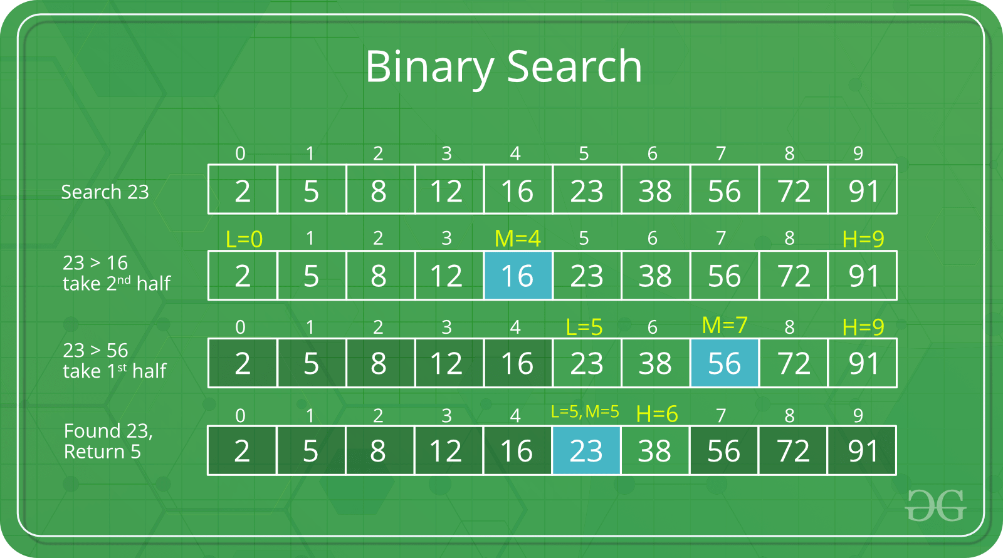
So we recur for the right half.
Else (x is smaller) recur for the left half.

Slide 11

Binary search program
using System;
using System.Collections.Generic;
using System.Linq;
using System.Text;
using System.Threading.Tasks;
namespace Binarysearch
{
class Searching
{
// Returns index of x if it is present in
// arr[l..r], else return -1
static int binarySearch(int[] arr, int l, int r, int x)
{
if (r >= l)
{
int mid = l + (r - l) / 2;
// If the element is present at the
// middle itself
if (arr[mid] == x)
return mid;
// If element is smaller than mid, then
// it can only be present in left subarray

Slide 12
if (arr[mid] > x)
return binarySearch(arr, l, mid - 1, x);
// Else the element can only be present
// in right subarray
return binarySearch(arr, mid + 1, r, x);
}
// We reach here when element is not present
// in array
return -1;
}
internal class Program
{
static void Main(string[] args)
{
int[] arr = { 2, 5, 8, 12, 16, 23, 38, 56, 72, 91 };
int n = arr.Length;
int x = 23;
int result = binarySearch(arr, 0, n - 1, x);
if (result == -1)
Console.WriteLine("Element not present");
else
Console.WriteLine("Element found at index " + result);
Console.ReadLine();
}
}
}
}

Slide 13
Thank Q

